Slide 1

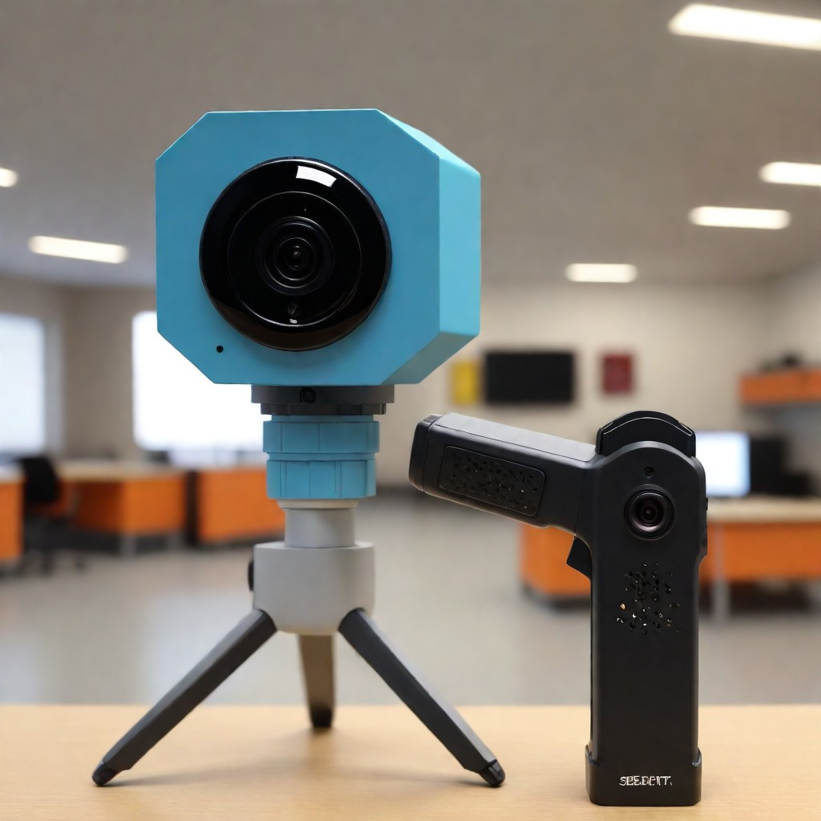
GUARDIAN EYE
Final Presentation

Slide 2

IS 637 – IS PROJECT & CHANGE MANAGEMENT
Priyanka Chaudhari
Venkat Pranav Gopisetty
Aishwarya Chiluka
Hari Bokka
Sravana Sri Burra
Sreekar Royal Pasupuleti

Slide 3


INTRODUCTION
FEASIBILITY STUDY
PURPOSE & SCOPE
CHARTER & PHASES
STAKEHOLDER ANALYSIS & GROUP DEFINITIONS
PROCESS METHODOLOGY & TIMELINE
RESOURCE DEFINITION & ALLOCATION
PROJECT COST ESTIMATE & BEA/ROI
QUALITY ASSURANCE
RISK ASSESSMENT
GLOBAL MARKET TREND
FUTURE MARKET TREND
CONCLUSION
Agenda

Slide 4

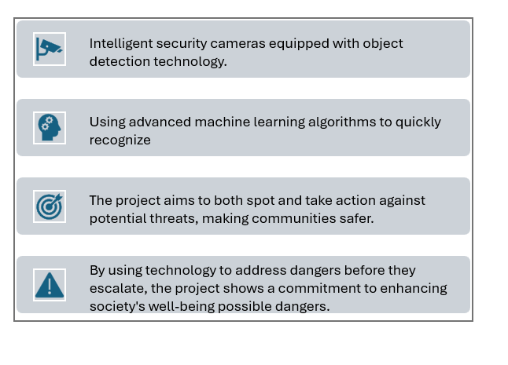
INTRODUCTION

Slide 5
FEASIBILITY STUDY -PRIYANKA

Slide 6
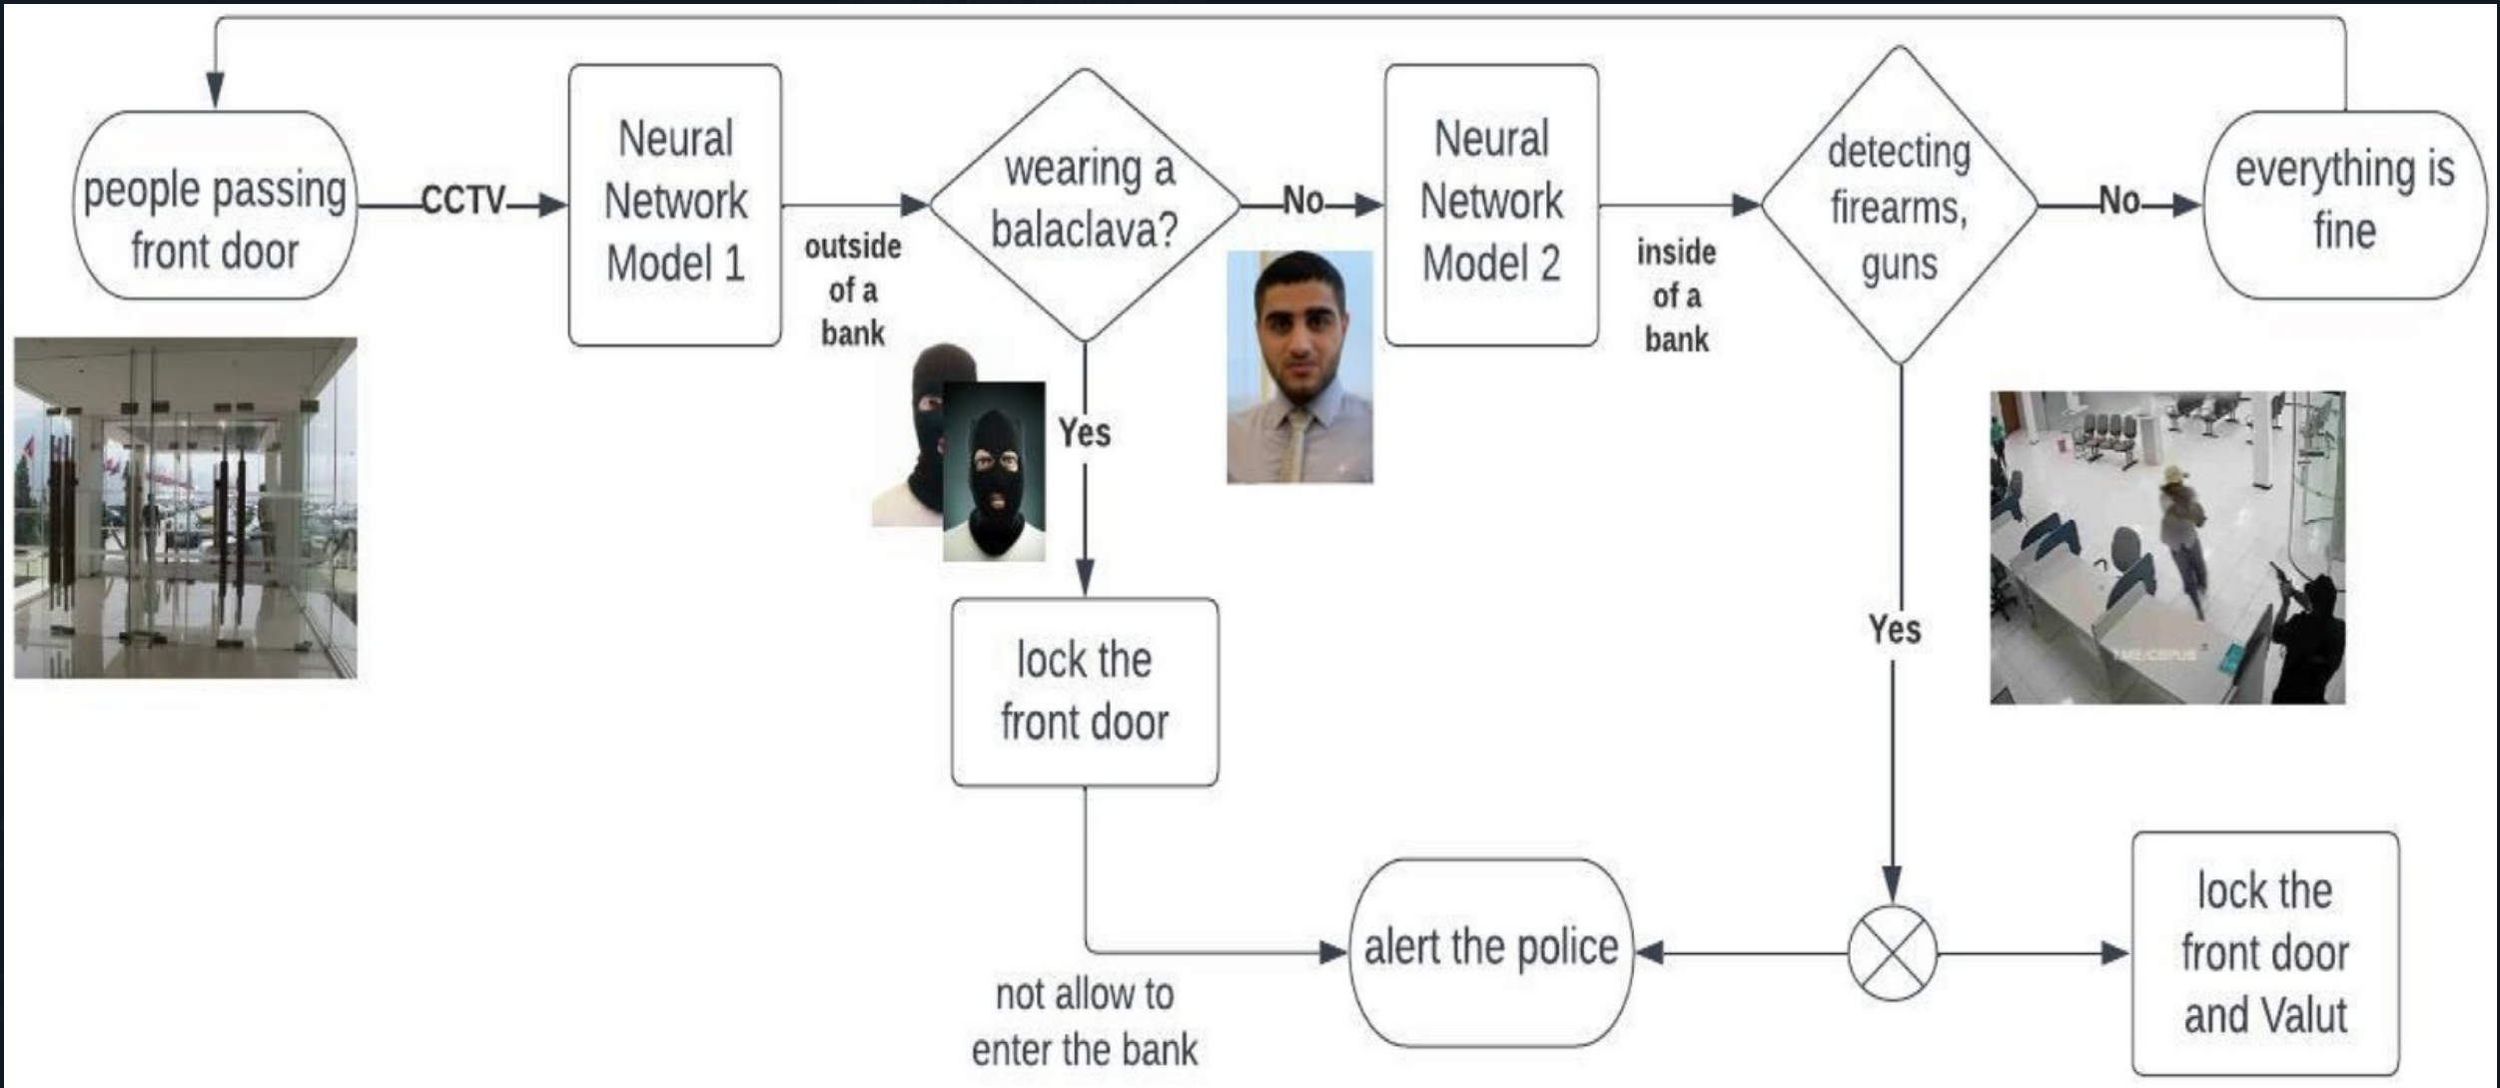
FEASIBILITY STUDY

Slide 7
PURPOSE & SCOPE
PHASES
PROCESS METHODOLOGY - HARI

Slide 8
PURPOSE & SCOPE
The purpose and scope of the Guardian Eye project involve defining the overarching goals and objectives to enhance public safety through advanced technology.
This includes specifying the project's boundaries, intended outcomes, and target audience to align with strategic business objectives
By clearly outlining the scope, the project can focus on delivering specific results and managing stakeholder expectations effectively.

Slide 9
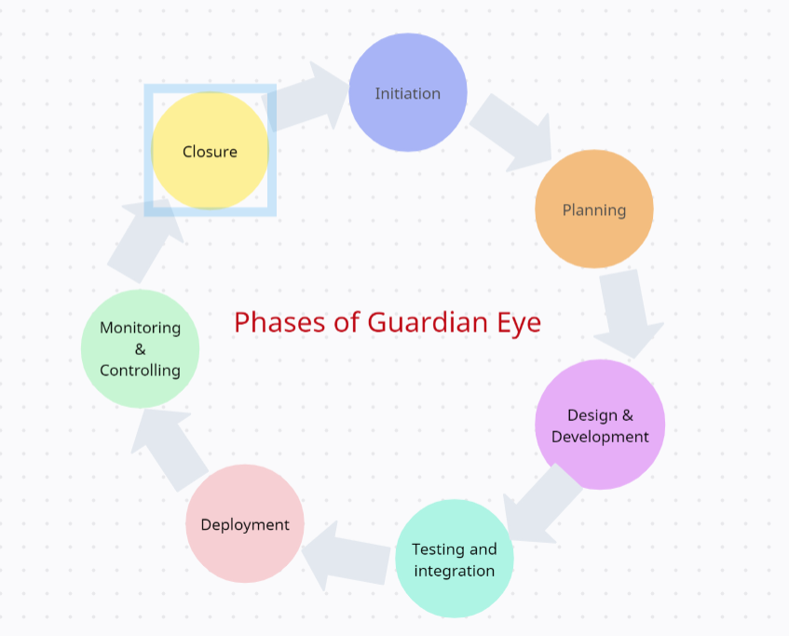
PHASES

Slide 10
PROCESS METHODOLOGY
The process methodology and timeline of the Guardian Eye project determine how activities will be executed and monitored
Selecting an appropriate project methodology, such as Agile or Waterfall, guides the project's workflow and decision-making processes.
Developing a detailed timeline with milestones and deliverables ensures that project progress is tracked effectively, and resources are allocated efficiently to meet project deadlines.
Allocate resources based on the timeline.
Implement tracking mechanisms for progress monitoring.

Slide 11
STAKEHOLDER MATRIX STAKEHOLDER ANALYSIS
- SRAVANA SRI

Slide 12

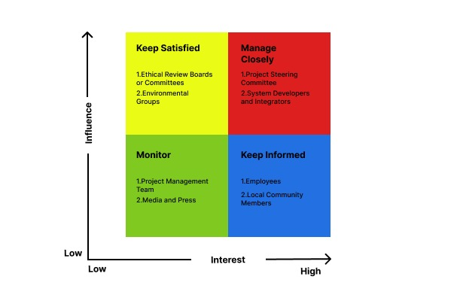
STAKEHOLDER MATRIX

Slide 13
STAKEHOLDER ANALYSIS

Slide 14
GANTT CHART RESOURCE DEFINITION & ALLOCATION RACI CHART - AISHWARYA

Slide 15
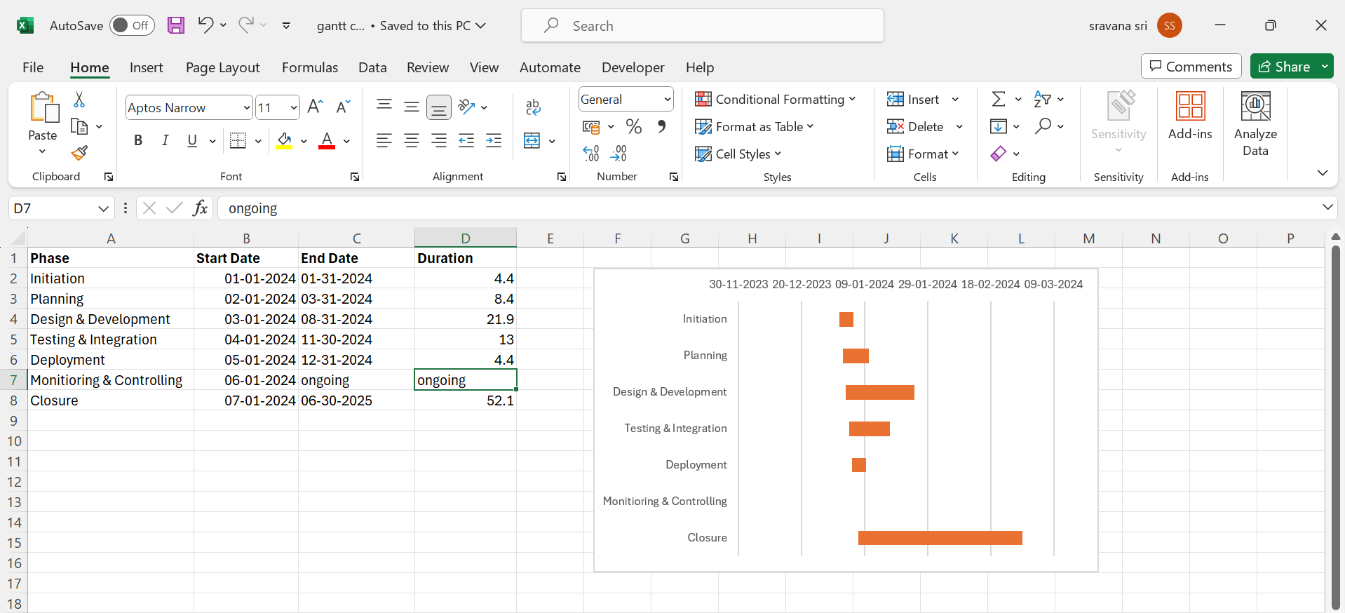

GANTT CHART

Slide 16
RESOURCE DEFINITION & ALLOCATION
Technology resource
Time Resources
Hardware, software, Networking Infrastructure
Project Schedule,
Work Hours
Human Resources
Project Manager
Technical Lead
Systems Analyst
Legal Advisor
Environmental Consultant
Financial Resources
Physical Resources
Budget,
Financial Management Tools
Office Space,
Testing Facilities,
Training Facilities

Slide 17
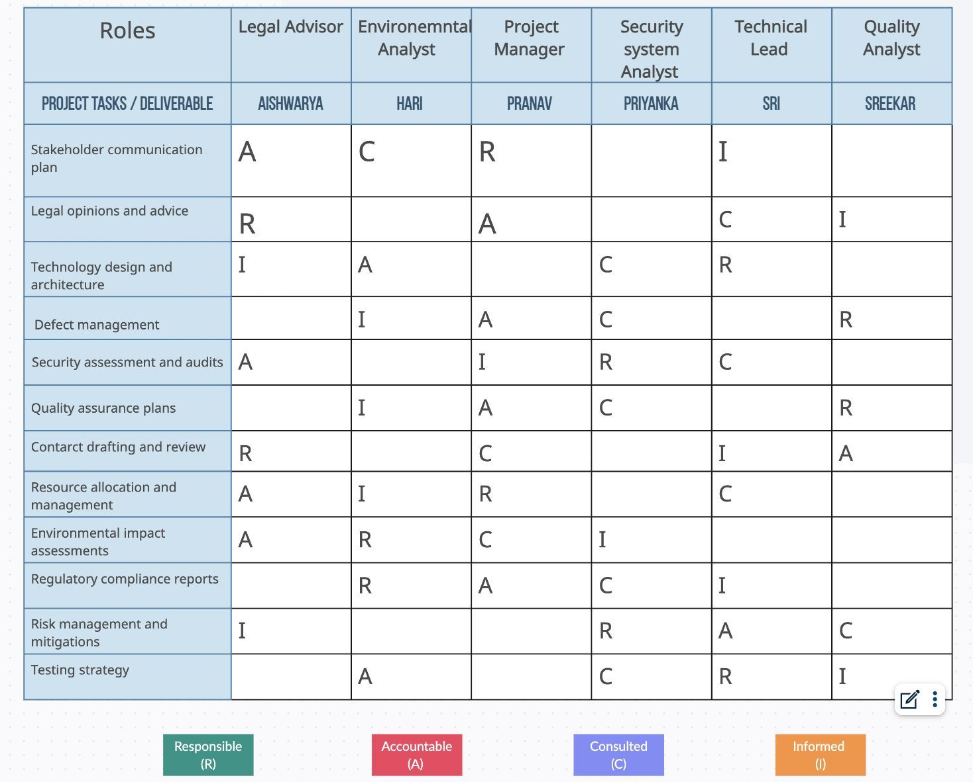
RACI CHART

Slide 18
PROJECT COST ESTIMATION
COMPARISION
BREAK EVEN POINT
- SREEKAR

Slide 19


PROJECT COST ESTIMATION

Slide 21
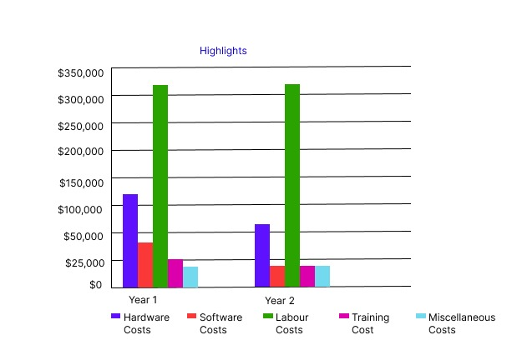
COMPARISION

Slide 22
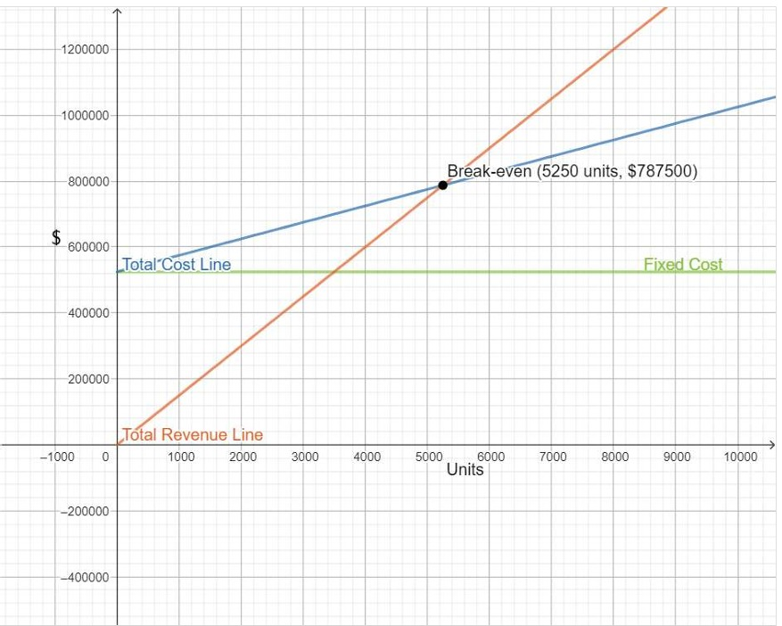
BREAK EVEN POINT
1. Per unit Retail = 54.00 $ + Taxes
2. Target to sell 5250 units to reach break even.
3.The break-even point is less than the units sold (U), the company makes a profit

Slide 23
QUALITY ASSURANCE
RISK MANAGEMENT
RISK ASSESSMENT - PRIYANKA

Slide 24
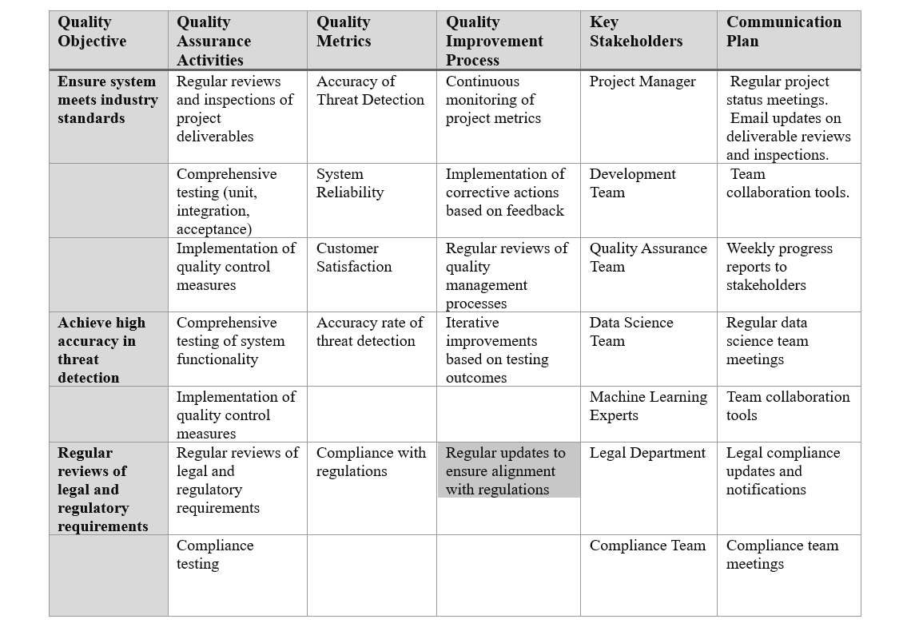
QUALITY ASSURANCE

Slide 25
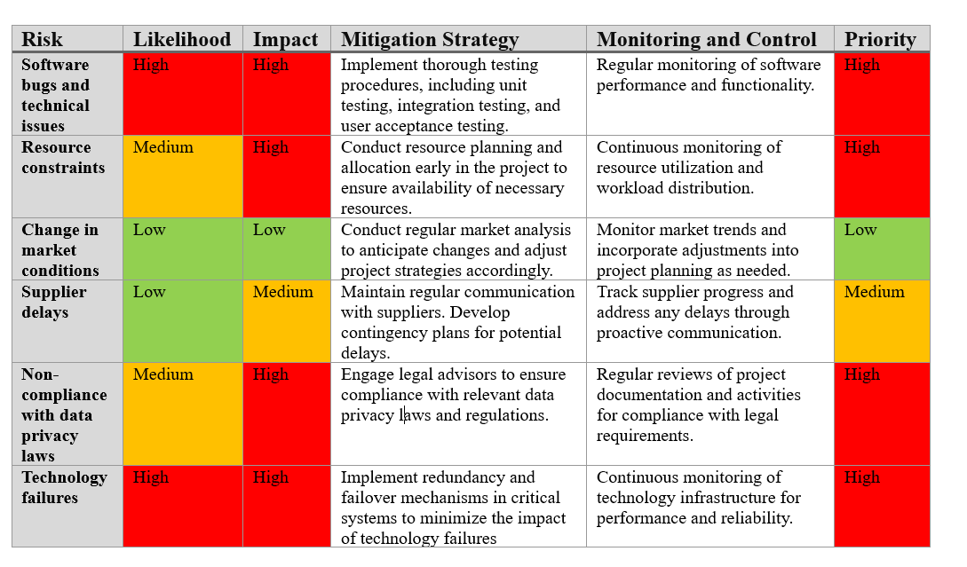
RISK ASSESSMENT

Slide 26
WIREFRAMES COMPETITION STATISTICS MARKET TREND SUCCESS STRATEGY CONCLUSION - PRANAV

Slide 27
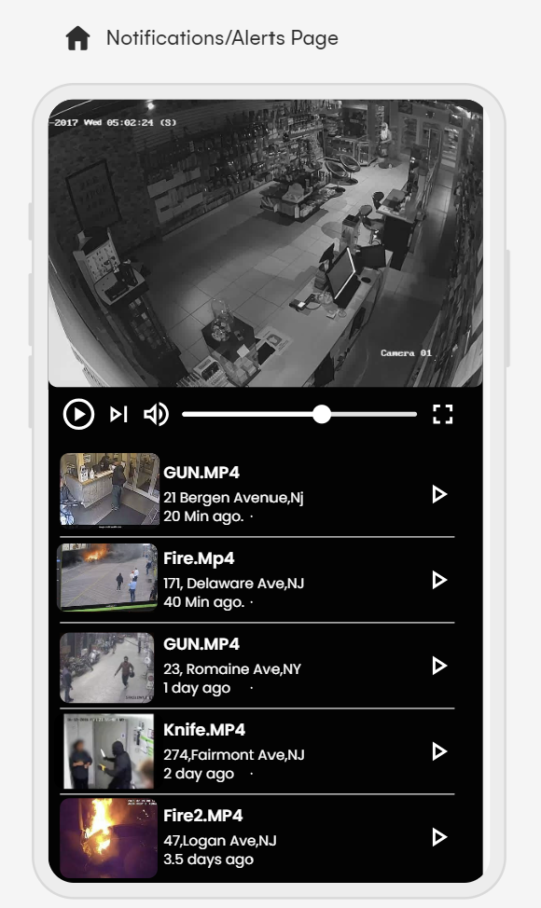
WIRE FRAMES OF APPLICATION

Slide 28
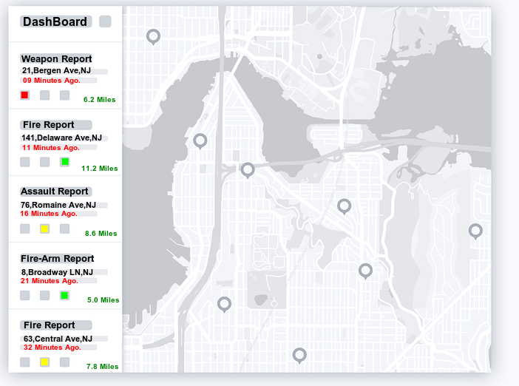
WEB APPLICATION SAMPLE WIRE FRAME

Slide 29
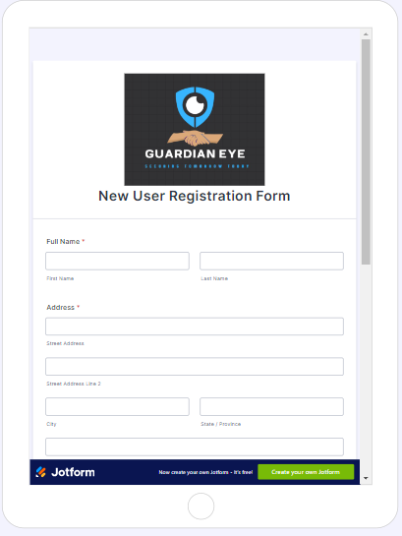

Slide 30
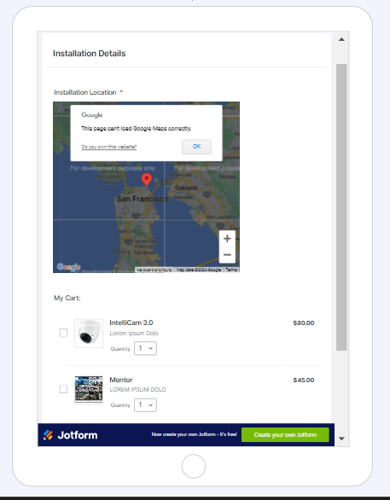

Slide 31
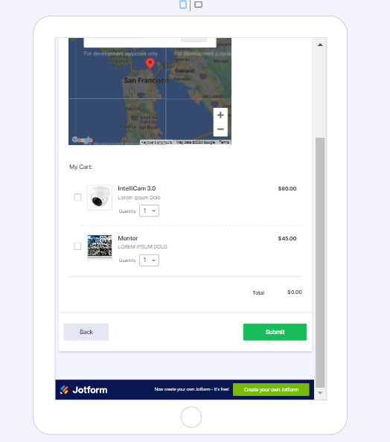

Slide 32
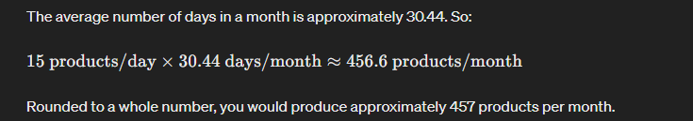
Project Success through Break Even Analysis
Key Highlights:
1. Per unit Retail = 54.00 $ + Taxes
2. Target to sell 5250 units to reach break even.
3.The break-even point is less than the units sold (U), the company makes a profit
Sale Target :

Slide 33
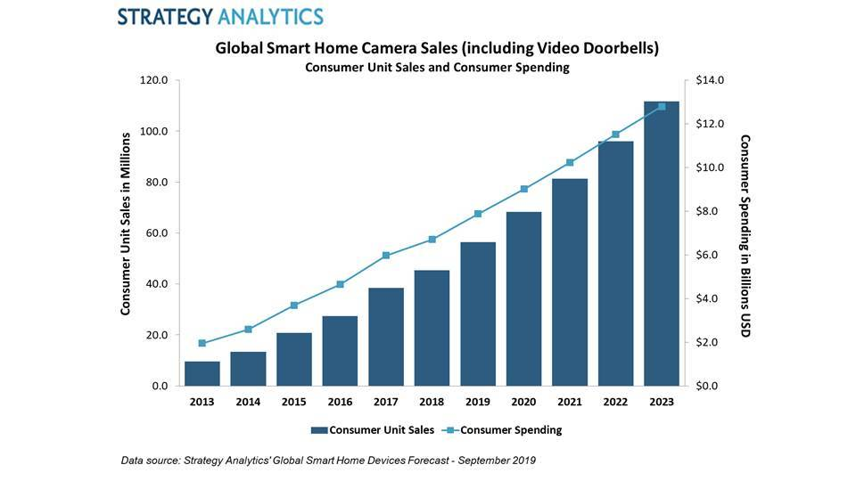
OUR COMPETITION STATISTICS

Slide 34
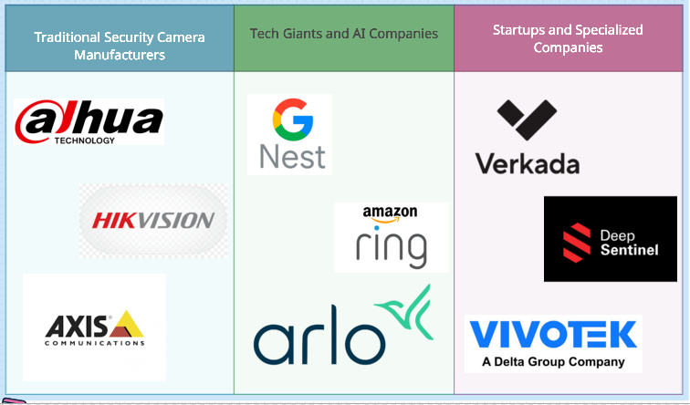
OUR KEY COMPETITORS

Slide 35
KEY HIGHLIGHTS OVER COMPETITION
1.Specialization in Hazardous Object Detection
2.Comprehensive Solution with Video Evidence
3.Most Economical Alternative with User-Friendly Interface
4.Real-Time Alerting and Response:

Slide 36
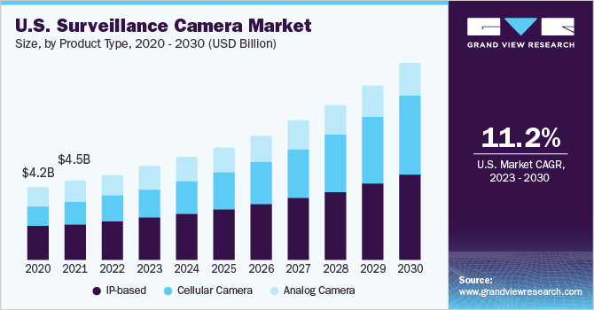
FUTURE MARKET TRENDS

Slide 37
CONCLUSION
Effective stakeholder management is critical for project success
Robust quality assurance practices ensure high project standards
Thorough risk assessment helps identify and mitigate potential threats
Cohesive team membership fosters collaboration and accountability
Tailored communication strategies address stakeholder needs and concerns

Slide 38




We would like to Thank Everyone and Professor for the help!

